Slide 1

Install and Configure ECM & Approval Hub Mobile Applications
Android Devices
This guide provides technical users with comprehensive instructions for installing and configuring the ECM Mobile Application and Approval Hub Application on Android devices, ensuring seamless workflow management and approvals.

Slide 2

Introduction to ECM & Approval Hub
This user guide provides step-by-step instructions on how to install and configure the ECM Mobile Application and the Approval Hub Application on Android devices.
ECM Mobile Application
Approval Hub Application
Lightweight app for on-the-go work item management:
View and action work items efficiently
Forward and reply to items
Digitally sign or initiate workflows
Centralized interface for quick approvals:
Consolidates pending approvals from systems like ECM, UPS,
End of Service, eBEAMS, and Payments
Streamlines the approval process from Easy Memo

Slide 3



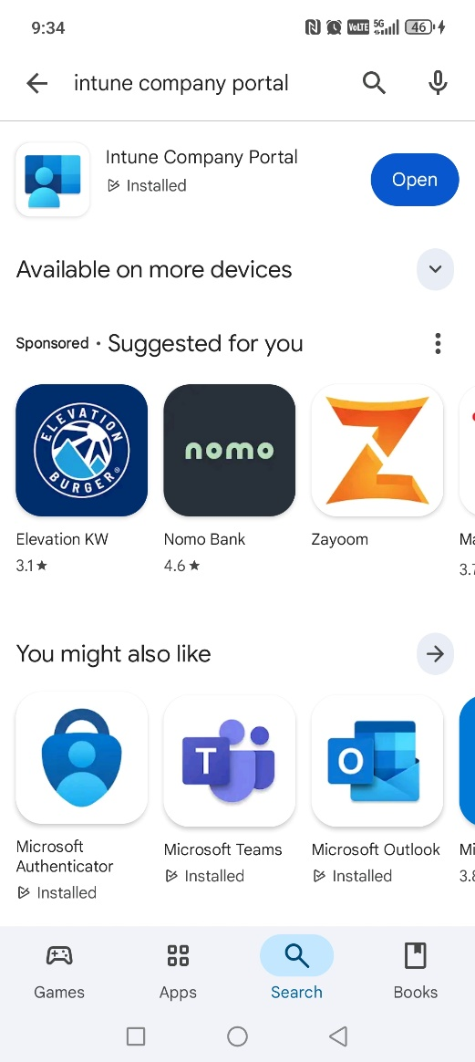
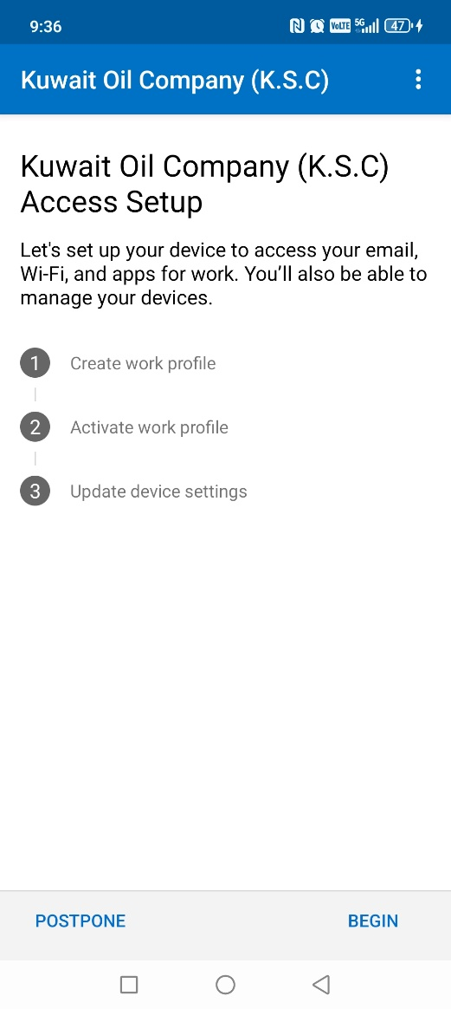
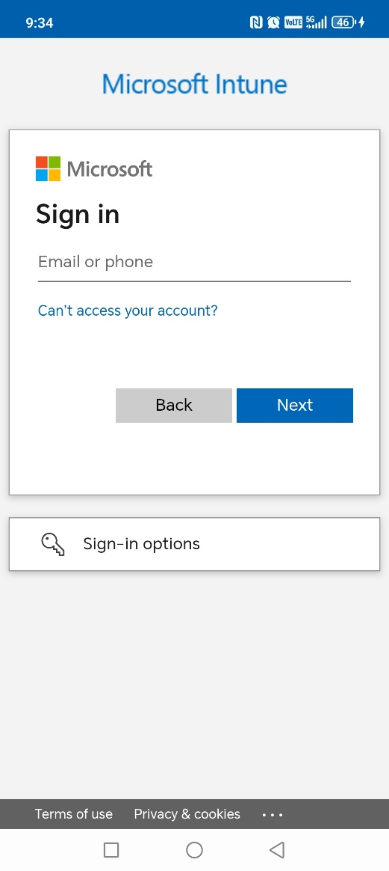
Installing Intune Company Portal (Android)
1. Download and install the Intune Company Portal application from the Google Play Store.
2. Launch Intune Company Portal, enter your KOC email and password, ensuring the Authenticator app is already installed and activated.
.
3. Tap "Begin" to automatically create your Work Profile.

Slide 4



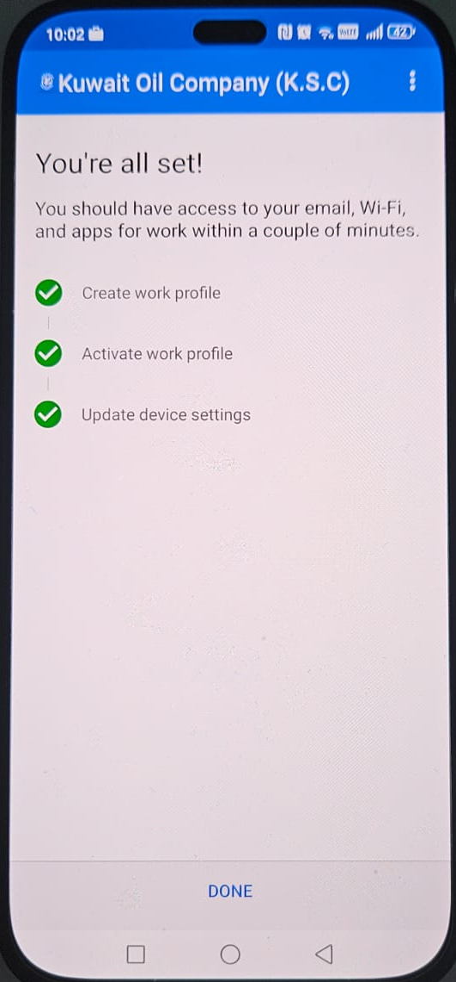
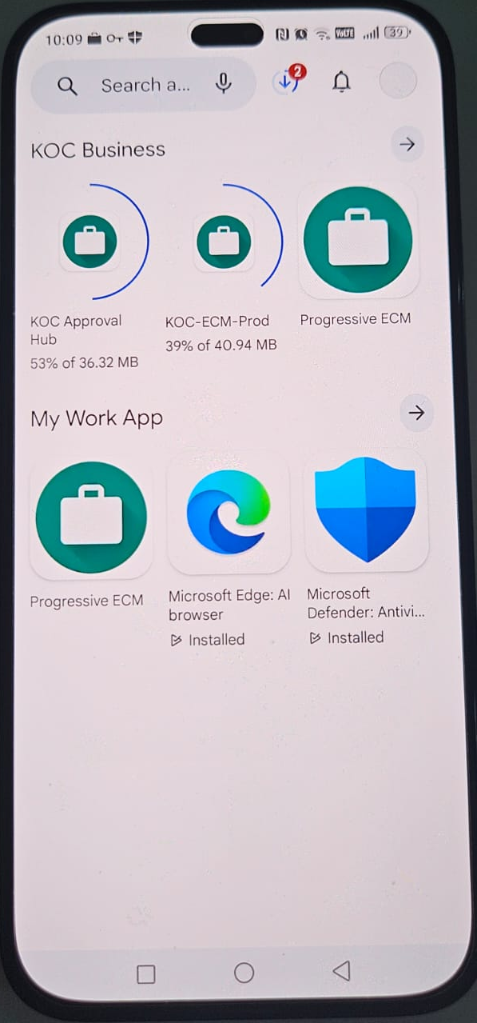
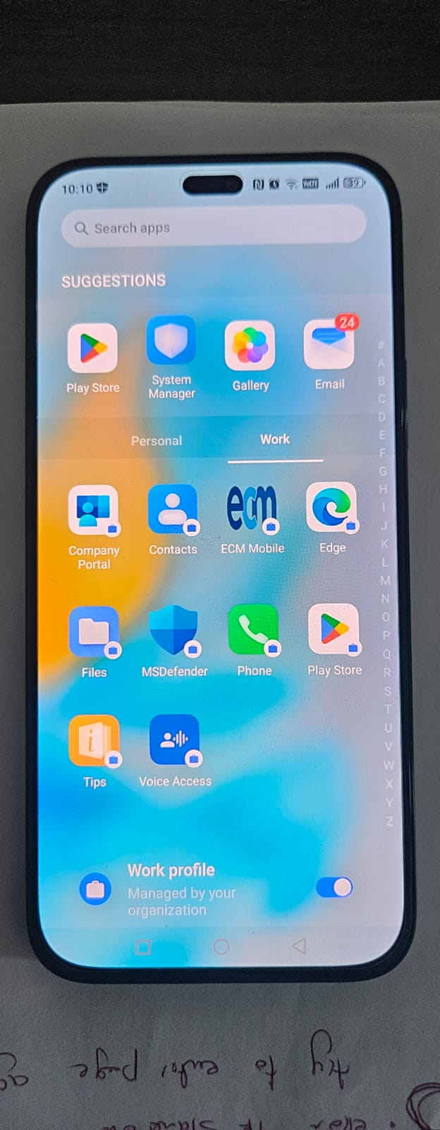
Configure Intune Company Portal (Android)
4. Activate your work profile on your device by tapping the mobile icon, which will activate your device.
5. Download ECM & Approval Hub applications directly from the Google Play Store within the Work Profile.
6. Ensure the "Work Profile" button is enabled. Your Work Profile is now successfully ready for use.

Slide 5
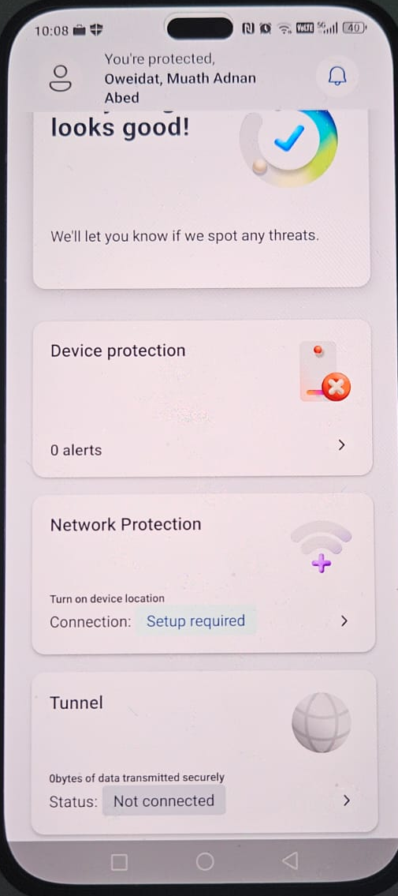
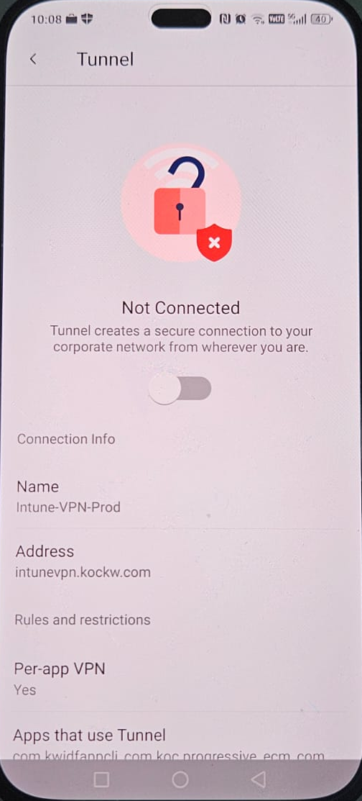
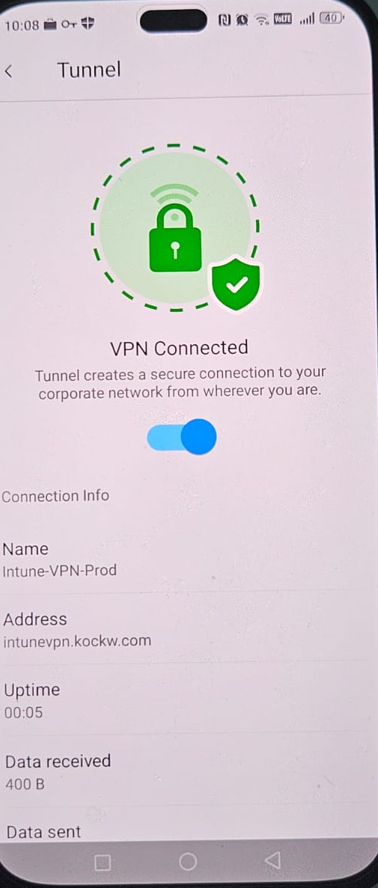
Activate VPN using MS Defender
To securely use the applications, you must enable MS Defender on your mobile device to ensure encrypted and secure access to corporate resources.
Open MS Defender application, then tap on Tunnel.
Enable the VPN toggle to connect to the secure network.
Confirm VPN connection once the status shows "Connected."

Slide 6



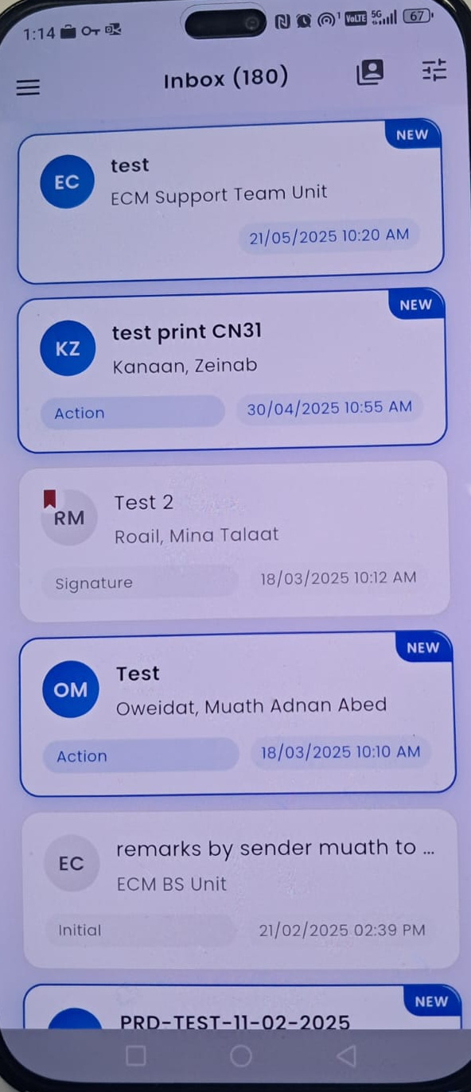
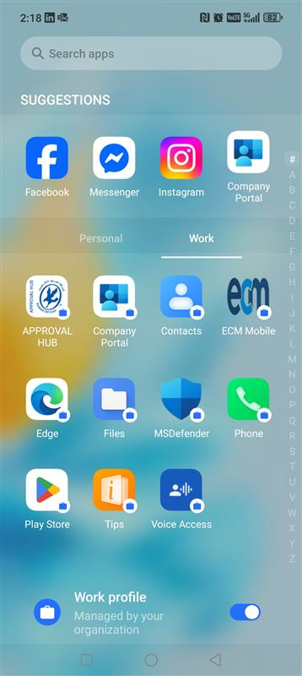
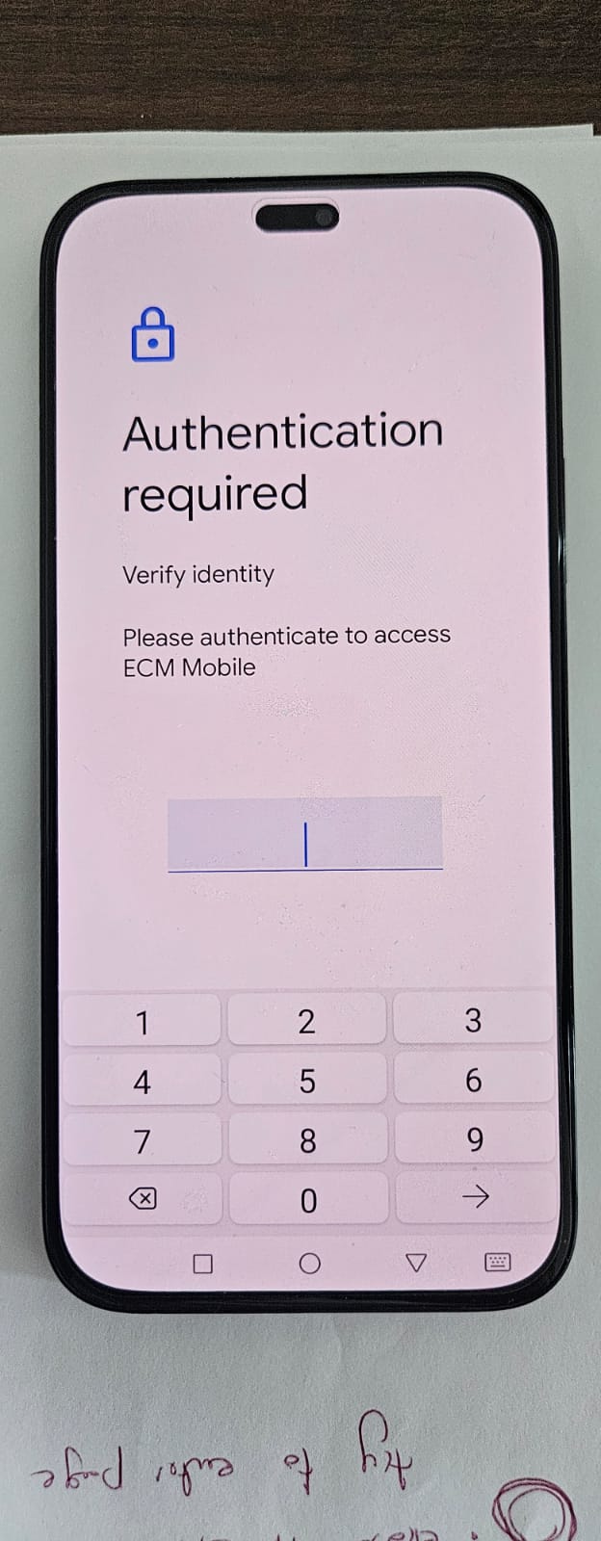
Run ECM Mobile Application
Launch ECM
Authenticate
Ready to Use
From the Work Profile, tap the ECM mobile application icon to launch.
Enter the required authentication number when prompted for secure access.
Your ECM Mobile Application is now ready for efficient use and workflow management.

Slide 7
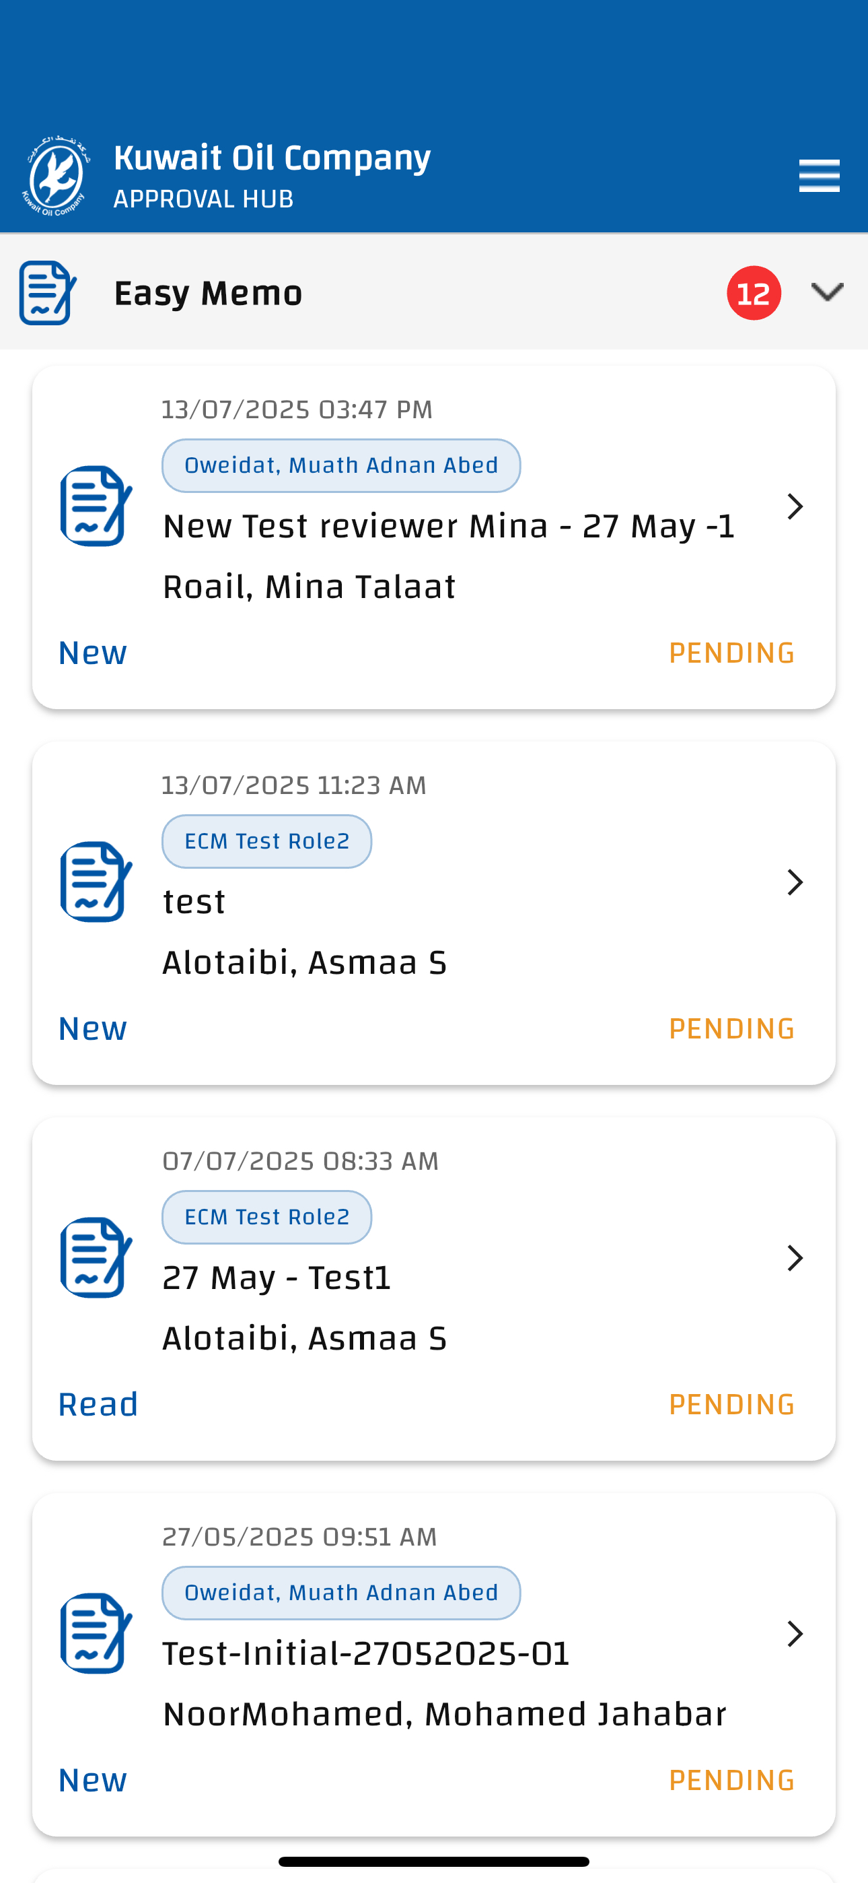
Run Approval Hub Mobile Application
Launch ECM
Authenticate
Ready to Use
From the Work Profile, tap the Approval Hub mobile application icon to launch.
Enter the required authentication number when prompted for secure access.
Your Approval Hub Mobile Application is now ready for use.

